Slide 1
Training: What, Why and How ?
D Tulasi Jyothi

Slide 2
My experience
As a Teacher
Worked In CBSE Schools( Adarsh Public School Visakhapatnam
Navy Children School Sri Chaitanya Techno School Visakhapatnam
As a Principal
Worked in Sri Chaitanya Techno School Visakhapatnam
Worked in Ravindra Bharathi School Hyderabad
Worked in AP Model School Durgi, Guntur ( Dist)
Working in AP Model School Venkatagiri, Tirupati ( Dist)
As a Trainer
ADOLCESCENCE Education
Career Guidelines

Slide 3
Activity:1
Your perception about the change from State Board to CBSE in terms of SWOT
My Expectations

Slide 4
Training Targets
Informative: Curriculum, New @Knowledge, SOPs
Pedagogical: As recommended in NEP 2020
Assessment: Item writing - evaluation – analysis of items and procedures
Research

Slide 5
Human Attributes:
Individual Differences:
◦Adaptability
◦Intelligence
◦Personality
◦Attitude
◦Interest
◦Aptitude
Individual differences in human attributes are demanding “Individualized Training”

Slide 6
Training Pedagogy/Andragogy
Readiness
Identification of Current level of Skill Set
Engagement

Slide 7
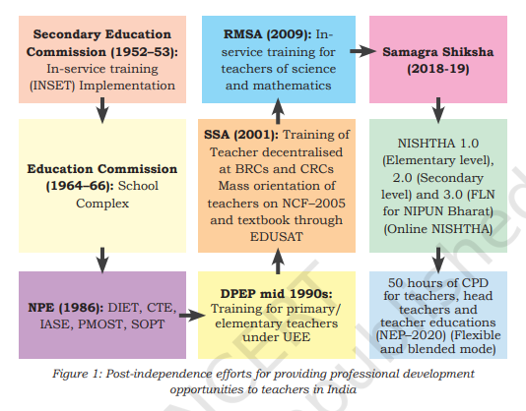

Slide 8
NEP 2020: Continuous Professional Development (CPD)
1.Teachers will be given continuous opportunities for self-improvement and to learn the latest innovations and advances in their professions.
2.These will be offered in multiple modes, including in the form of local, regional, state, national, and international workshops as well as online teacher development modules.
3.Platforms (especially online platforms) will be developed so that teachers may share ideas and best practices.
4.Each teacher will be expected to participate in at least 50 hours of CPD opportunities every year for their own professional development, driven by their own interests.
5.CPD opportunities will cover the latest pedagogies

Slide 9
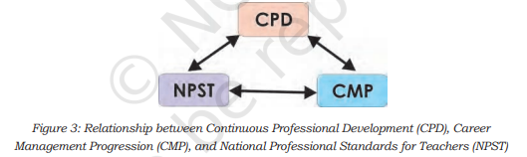
NCERT CPD Guidelines

Slide 10
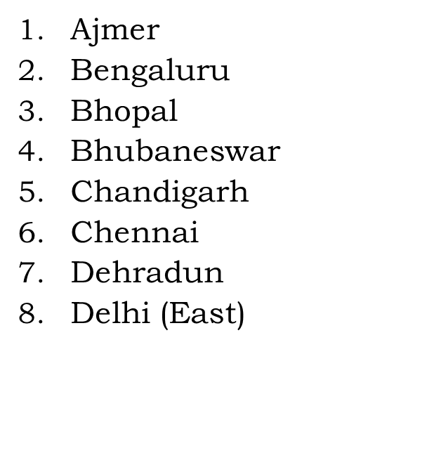
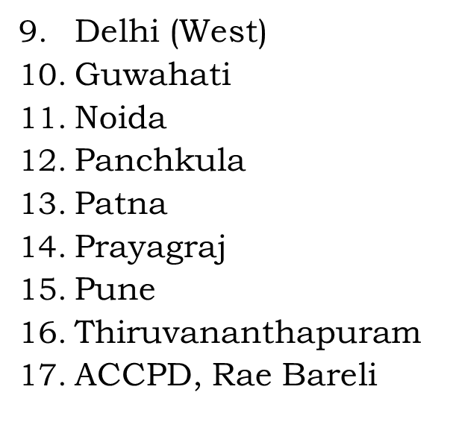
CBSE Centre of Excellence (CoE)

Slide 11



Slide 12
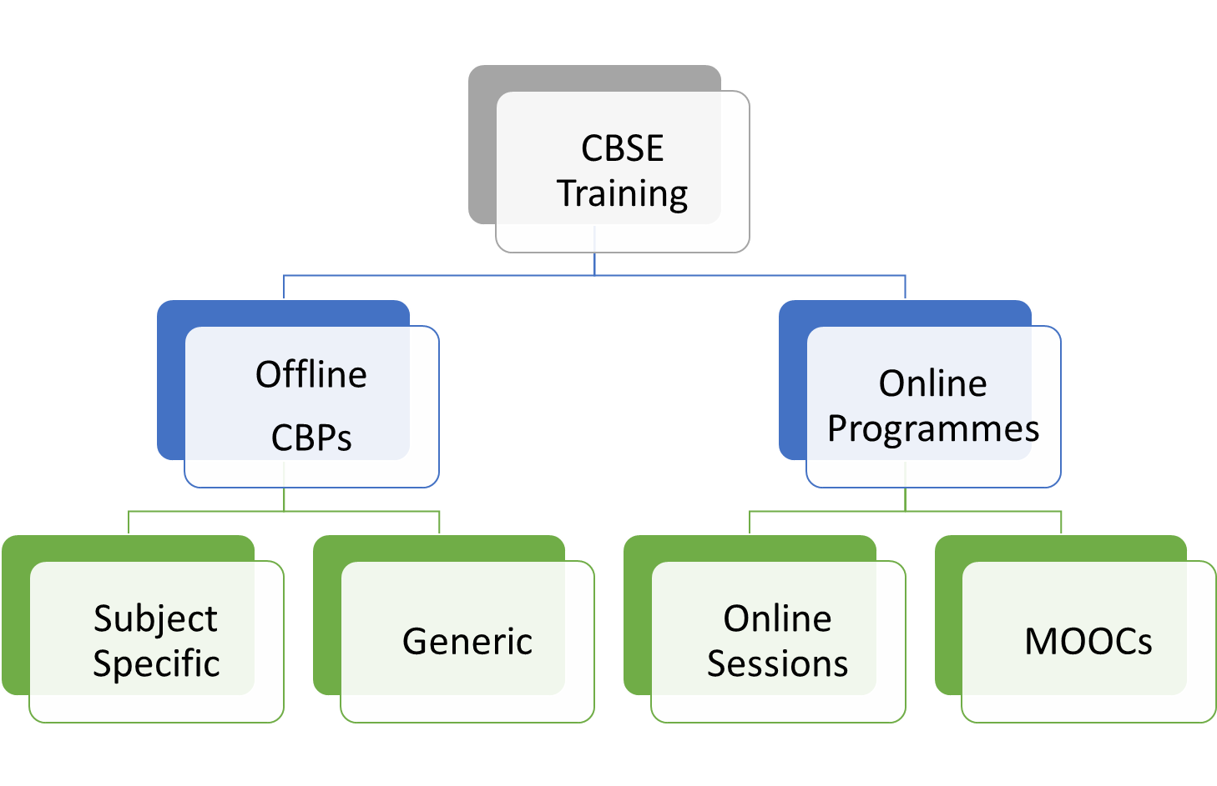

Slide 13
Salient Features of CBSE Training
Activity Based
Multiple means of engagement
Resource Persons
Know Your Children
Workshop to workplace
Feedback

Slide 14
Recent Initiatives of the Training Unit
1.Annual Training Theme 2022-23:
2.Training MIS:
3.Subject based Training Need Analysis:
4.Training Impact Analysis:
5.Engagement of Resource Persons from other Organizations:
6.Teachers’ Portfolio:
7.Introduction of new Capacity Building Programmes (CBPs):

Slide 15
Activity: 2
What are the characteristics of a good teacher?
Can training make any difference in the pedagogy of teacher?
Your suggestions for the improvement of quality of education
Your suggestions for the inclusive education

